Slide 1
Python functions and generators

Slide 2

How does a function look like?
def name(parameter1, parameter2, . . .):
body
OR
def new_name():
body
OR
def another_name(kwarg=’Test’):
body

Slide 3
In other words, functions in python are specified by an indentation block wrapped under
a def name() that may or may not have any arguments.
A function in python may also return a var or return None by default if no return is specified
def fact(n):
"""Return the factorial of the given number."""
r = 1
while n > 0:
r = r * n
n = n - 1
return r
The marked in green is called docstring and is available by calling fact.__doc__

Slide 4
Functions as first class objects
In Python, it is not only data types that are treated as objects. Both functions and classes are
what are known as first class objects, allowing them to be manipulated in the same ways as
built-in data types. By definition, first class objects are:
Created at runtime
Assigned as a variable or in a data structure
Passed as an argument to a function
Returned as the result of a function
In Python, the term first class object is a bit of a *misnomer since it implies some sort of
hierarchy, whereas all Python objects are essentially first class.
*погрешно наименование

Slide 5
How first class object look like?
def greeting(language):
if language == 'eng':
return 'hello world'
if language == 'fr':
return 'Bonjour le monde'
else:
return 'language not supported'
Since user-defined functions are objects, we can do things such as include them in other
objects, such as lists:
greetings = [greeting('ger'), greeting('fr'), greeting('it'), greeting('eng')]

Slide 6
Functions can also be used as arguments for other functions. For example, we can define the
following function:
def callf(f):
lang = 'eng'
return f(lang)
callf(greeting)
>>> 'hello world'
We could see how this would be useful if, for example, we wanted to produce a program that returns specific sentences in a variety of languages, perhaps for some sort of natural language application.

Slide 7
Higher order functions
Functions that take other functions as arguments, or that return functions, are called higher
order functions.
Python 3 contains two built-in higher order functions, filter() and map(). Note that in earlier versions of Python, these functions return lists; in Python 3, they return an iterator, making them much more efficient.
The map() function provides an
easy way to transform each item into an iterable object. For example, here is an efficient,
compact way to perform an operation on a sequence. Note the use of the lambda
anonymous function:

Slide 8
lst = [1, 2, 3, 4]
list(map(lambda x: x ** 3, lst))
[1, 8, 27, 64]
list(filter(lambda x: x < 3, lst))
[1, 2]

Slide 9
There does not seem to be a great deal of difference in the
performance characteristics apart from a slight performance advantage when using the in
built functions map and filter without the lambda operator, compared to list
comprehensions. Despite this, most style guides recommend the use of list comprehensions
over built-in functions, possibly because they tend to be easier to read.

Slide 10
Creating our own higher order functions is one of the hallmarks of functional programming
style. A practical example of how higher order functions can be useful is demonstrated by
the following. Here we are passing the len function as the key to the sort function. This
way, we can sort a list of words by length.
words = str.split('The longest word in this sentence')
print(sorted(words, key=len))
>>> ['in', 'The', 'word', 'this', 'longest', 'sentence']

Slide 11
function parameters
Most functions need parameters, and each language has its own specifications for how
function parameters are defined. Python is flexible and provides three options for
defining function parameters.
Positional arguments
Passing arguments by parameter name
Variable numbers of arguments

Slide 12
Positional arguments
The simplest way to pass parameters to a function in Python is by position. In the first
line of the function, you specify variable names for each parameter, when the func-
tion is called, the parameters used in the calling code are matched to the function’s
parameter variables based on their order.
Example:
def power(x, y):
result = 1
while y > 0:
result *= x
y -= 1
return result

Slide 13
Positional arguments
Example 2:
power(2, 3)
>>> 8
power(3, 2)
>>> 9
When dealing with positional arguments you must remember, that order matters.

Slide 14
Parameters default values
Python function parameters can also have default values.
def power(x, y=2):
result = 1
while y > 0:
result *= x
y -= 1
return result
Now if we do not pass explicitly y value when calling power, the result will be calculated
using the default value of y (2).
power(3)
>>> 9

Slide 15
Important warning: The default value is evaluated only once. This makes a difference when the default is a mutable object such as a list, dictionary, or instances of most classes. For example, the following function accumulates the arguments passed to it on subsequent calls:

Slide 16
function parameters
Having in mind the previous definition of power, you must always specify the arguments in correct order by priority, i.e. parameters without default values are 1st, after that we place those with default values and after that any additional arguments.
power(3, y=4) —> Correct
power(y=4, 3) —> Incorrect
print(power(y=4, 3))
^
SyntaxError: positional argument follows keyword argument

Slide 17
Passing parameters by name
This technique allows you to change the order of the arguments as long as you pass their
name=value within a function call.
Example:
power(y=3, x=2)
>>> 8
Using keyword arguments can be very useful if your function has a lots of arguments!

Slide 18
Numerous number of arguments
In some cases you may need your function to handle numerous of arguments and obviously
you wouldn’t know their count prior.
Example:
def users_list(main_user, *users):
print(main_user)
for user in users:
print(user)

Slide 19
Numerous *args and **kwargs
A more extended version of the previous function would look like this:
Example:
def users_list(main_user, *users, main_user_age=None, **users_options):
print(main_user, main_user_age)
for user in users:
print(user, users_options.get(user))
Example call:
users_list(
'User1', *[f'User{x}' for x in range(19)],
main_user_age=25, **{f'User{x}': (x+1)*19 for x in range(19)},
)
We will check the output within lecture.

Slide 20
The following example shows how (optional) positional arguments and (optional) keyword arguments may be passed to a given function upon invocation.
def f6(arg1, arg2=None, *args, **kwargs):
print('arg1 = {}. arg2 = {}. args = {}. kwargs = {}.\n'
.format(arg1, arg2, args, kwargs))
f6(0) # At least one argument is required for f6().
f6(0, one=1, two=2)
f6(0, 1, one=1, two=2)
f6(0, 1, 2, one=1, two=2)
f6(0, 1, 2, 3, one=1, two=2)
f6(0, 1, 2, 3, 4, one=1, two=2)
f6(0, [1,2], 3, 4, one=1, two=2) # arg2 is passed as list.
f6(0, *[1,2], 3, 4, one=1, two=2) # arg2 is unpacked.

Slide 21
arg1 = 0. arg2 = None. args = (). kwargs = {}.
arg1 = 0. arg2 = None. args = (). kwargs = {'one': 1, 'two': 2}.
arg1 = 0. arg2 = 1. args = (). kwargs = {'one': 1, 'two': 2}.
arg1 = 0. arg2 = 1. args = (2,). kwargs = {'one': 1, 'two': 2}.
arg1 = 0. arg2 = 1. args = (2, 3). kwargs = {'one': 1, 'two': 2}.
arg1 = 0. arg2 = 1. args = (2, 3, 4). kwargs = {'one': 1, 'two': 2}.
arg1 = 0. arg2 = [1, 2]. args = (3, 4). kwargs = {'one': 1, 'two': 2}.
arg1 = 0. arg2 = 1. args = (2, 3, 4). kwargs = {'one': 1, 'two': 2}.

Slide 22
Special parameters
By default, arguments may be passed to a Python function either by position or explicitly by keyword. For readability and performance, it makes sense to restrict the way arguments can be passed so that a developer need only look at the function definition to determine if items are passed by position, by position or keyword, or by keyword.
A function definition may look like:
def f(pos1, pos2, /, pos_or_kwd, *, kwd1, kwd2):
----------- ---------- ----------
| | |
| Positional or keyword |
| - Keyword only
-- Positional only

Slide 23
where / and * are optional. If used, these symbols indicate the kind of parameter by how the arguments may be passed to the function: positional-only, positional-or-keyword, and keyword-only. Keyword parameters are also referred to as named parameters.
Positional-or-Keyword Arguments
If / and * are not present in the function definition, arguments may be passed to a function by position or by keyword.

Slide 24
Positional-Only Parameters
Looking at this in a bit more detail, it is possible to mark certain parameters as positional-only. If positional-only, the parameters’ order matters, and the parameters cannot be passed by keyword. Positional-only parameters are placed before a / (forward-slash). The / is used to logically separate the positional-only parameters from the rest of the parameters. If there is no / in the function definition, there are no positional-only parameters.
Parameters following the / may be positional-or-keyword or keyword-only.

Slide 25
Keyword-Only Arguments
To mark parameters as keyword-only, indicating the parameters must be passed by keyword argument, place an * in the arguments list just before the first keyword-only parameter.
Examples:
>>> def standard_arg(arg):
... print(arg)
...
>>> def pos_only_arg(arg, /):
... print(arg)
...
>>> def kwd_only_arg(*, arg):
... print(arg)
...
>>> def combined_example(pos_only, /, standard, *, kwd_only):
... print(pos_only, standard, kwd_only)

Slide 26
The first function definition, standard_arg, the most familiar form, places no restrictions on the calling convention and arguments may be passed by position or keyword:
>>> standard_arg(2)
2
>>> standard_arg(arg=2)
2
The second function pos_only_arg is restricted to only use positional parameters as there is a / in the function definition:
>>>
>>> pos_only_arg(1)
1
>>> pos_only_arg(arg=1)
Traceback (most recent call last):
File "<stdin>", line 1, in <module>
TypeError: pos_only_arg() got some positional-only arguments passed as keyword arguments: 'arg'

Slide 27
The third function kwd_only_args only allows keyword arguments as indicated by a * in the function definition:
>>>
>>> kwd_only_arg(3)
Traceback (most recent call last):
File "<stdin>", line 1, in <module>
TypeError: kwd_only_arg() takes 0 positional arguments but 1 was given
>>> kwd_only_arg(arg=3)
3

Slide 28
And the last uses all three calling conventions in the same function definition:
>>> combined_example(1, 2, 3)
Traceback (most recent call last):
File "<stdin>", line 1, in <module>
TypeError: combined_example() takes 2 positional arguments but 3 were given
>>> combined_example(1, 2, kwd_only=3)
1 2 3
>>> combined_example(1, standard=2, kwd_only=3)
1 2 3
>>> combined_example(pos_only=1, standard=2, kwd_only=3)
Traceback (most recent call last):
File "<stdin>", line 1, in <module>
TypeError: combined_example() got some positional-only arguments passed as keyword arguments: 'po

Slide 29
Finally, consider this function definition which has a potential collision between the positional argument name and **kwds which has name as a key:
def foo(name, **kwds):
return 'name' in kwds
There is no possible call that will make it return True as the keyword 'name' will always bind to the first parameter. For example:
>>>
>>> foo(1, **{'name': 2})
Traceback (most recent call last):
File "<stdin>", line 1, in <module>
TypeError: foo() got multiple values for argument 'name'
>>>

Slide 30
But using / (positional only arguments), it is possible since it allows name as a positional argument and 'name' as a key in the keyword arguments:
def foo(name, /, **kwds):
return 'name' in kwds
>>> foo(1, **{'name': 2})
True
In other words, the names of positional-only parameters can be used in **kwds without ambiguity.

Slide 31
Mutable objects as parameters
Arguments are passed in by object reference. The parameter becomes a new reference to the object. For immutable objects (such as tuples, strings, and numbers), what is done with a parameter has no effect outside the function. But if you pass in a mutable object (such as a list, dictionary, or class instance), any change made to the object changes what the argument is referencing outside the function. Reassigning the parameter doesn’t affect the argument.
Example:
age = 31
passed_ages = [_ for _ in range(1, 31)]
next_three_ages = [32, 33, 34]

Slide 32
Mutable objects as parameters
def update_ages(age, passed, future):
passed.append(age)
age += 1
future = [age + x for x in range(1, 4)]
print(age, future)
update_ages(age, passed_ages, next_three_ages)
print(age)
>>> 31
print(passed_ages)
>>> [...., 31]
print(future)
>>> [32, 33, 34]

Slide 33
By default if a function doesn’t define return value, it return None.
def some_function():
# body
result = some_function() —> None
which is the same as
def some_function():
# body
return
result = some_function() —> None

Slide 34
Scope in functions
A scope is a textual region of a Python program where a namespace is directly accessible. “Directly accessible” here means that an unqualified reference to a name attempts to find the name in the namespace.
Although scopes are determined statically, they are used dynamically. At any time during execution, there are 3 or 4 nested scopes whose namespaces are directly accessible:
the innermost scope, which is searched first, contains the local names
the scopes of any enclosing functions, which are searched starting with the nearest enclosing scope, contains non-local, but also non-global names
the next-to-last scope contains the current module’s global names
the outermost scope (searched last) is the namespace containing built-in names

Slide 35
If a name is declared global, then all references and assignments go directly to the middle scope containing the module’s global names. To rebind variables found outside of the innermost scope, the nonlocal statement can be used; if not declared nonlocal, those variables are read-only (an attempt to write to such a variable will simply create a new local variable in the innermost scope, leaving the identically named outer variable unchanged).
Usually, the local scope references the local names of the (textually) current function. Outside functions, the local scope references the same namespace as the global scope: the module’s namespace. Class definitions place yet another namespace in the local scope.

Slide 36
It is important to realize that scopes are determined textually: the global scope of a function defined in a module is that module’s namespace, no matter from where or by what alias the function is called. On the other hand, the actual search for names is done dynamically, at run time — however, the language definition is evolving towards static name resolution, at “compile” time, so don’t rely on dynamic name resolution! (In fact, local variables are already determined statically.)
A special quirk of Python is that – if no global or nonlocal statement is in effect – assignments to names always go into the innermost scope. Assignments do not copy data — they just bind names to objects. The same is true for deletions: the statement del x removes the binding of x from the namespace referenced by the local scope. In fact, all operations that introduce new names use the local scope: in particular, import statements and function definitions bind the module or function name in the local scope.

Slide 37
The global statement can be used to indicate that particular variables live in the global scope and should be rebound there; the nonlocal statement indicates that particular variables live in an enclosing scope and should be rebound there.
Scopes and Namespaces Example

Slide 38
def scope_test():
def do_local():
spam = "local spam"
def do_nonlocal():
nonlocal spam
spam = "nonlocal spam"
def do_global():
global spam
spam = "global spam"
…

Slide 39
spam = "test spam"
do_local()
print("After local assignment:", spam)
do_nonlocal()
print("After nonlocal assignment:", spam)
do_global()
print("After global assignment:", spam)
scope_test()
print("In global scope:", spam)

Slide 40
The output of the example code is:
After local assignment: test spam
After nonlocal assignment: nonlocal spam
After global assignment: nonlocal spam
In global scope: global spam
Note how the local assignment (which is default) didn’t change scope_test’s binding of spam. The nonlocal assignment changed scope_test’s binding of spam, and the global assignment changed the module-level binding.
You can also see that there was no previous binding for spam before the global assignment.

Slide 41
Scope in functions
age_module_scope = 31
print('Module scope: ', age_module_scope)
def scope_test():
var_one = 5
var_two = 6
ages = [25]
def scope_inner_test():
global age_module_scope
age_module_scope += 5
var_one = 6
var_two = 7
ages.append(26)
print('Inner scope: ', var_one, var_two, ages, age_module_scope)
scope_inner_test()
print('Outer scope: ', var_one, var_two, ages, age_module_scope)
scope_test()

Slide 42
Scope in functions
>>> Output:
Module scope: 31
Inner scope: 6 7 [25, 26] 36
Outer scope: 5 6 [25, 26] 36
Nothing extraordinary happened here.
The new one is the global keyword which allows us to mutate an outer level immutable
variable.

Slide 43
Assigning functions to variables
def add_two(x):
x += 2
return x
variable_add = add_two
print(variable_add(5))
>>> 7

Slide 44
lambda functions
Small anonymous functions can be created with the lambda keyword. This function returns the sum of its two arguments: lambda a, b: a+b. Lambda functions can be used wherever function objects are required. They are syntactically restricted to a single expression. Semantically, they are just syntactic sugar for a normal function definition. Like nested function definitions, lambda functions can reference variables from the containing scope
For example:
iterable.sort(key=function) - lambda can be used as a key value.
Or:
variable_add = lambda x: x + 2
print(variable_add(5))
>>> 7
** However the last example is not recommended to be used according to PEP8.

Slide 45
lambda expressions
students_data = [
{
'name': 'Tosho',
'age': 25,
'discipline': 'mathematics',
},
{
'name': 'Gosho',
'age': 27,
'discipline': 'IT',
},
{
'name': 'Ivan',
'age': 29,
'discipline': 'informatics',
}
]

Slide 46
lambda functions
students_data.sort(key=lambda data: data['discipline'])
print(students_data)
>>> [{'name': 'Gosho', 'age': 27, 'discipline': 'IT'}, {'name': 'Ivan', 'age': 29, 'discipline': 'informatics'}, {'name': 'Tosho', 'age': 25, 'discipline': 'mathematics'}]

Slide 47
Generators
A generator function is a special kind of function that you can use to define your own
iterators. When you define a generator function, you return each iteration’s value
using the yield keyword. The generator will stop returning values when there are no
more iterations, or it encounters either an empty return statement or the end of the
function. Local variables in a generator function are saved from one call to the next,
unlike in normal functions.

Slide 48
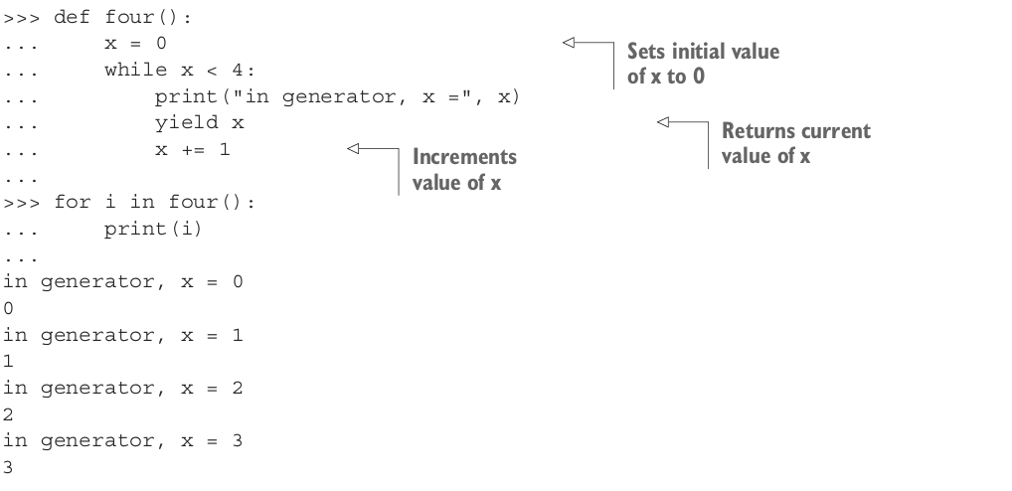

Slide 49
Generators
Note that this generator function has a while loop that limits the number of times
the generator executes. Depending on how it’s used, a generator that doesn’t have
some condition to halt it could cause an endless loop when called.
In general, generators are really useful in the following cases:
You need to process a huge amount of data and you need to save memory
You need to serve huge amount of data, i.e. streaming responses
You need to regroup huge amount of data into smaller pieces
As you can see, if you have to deal with huge amount of data, may be you should think
about using generators.

Slide 50
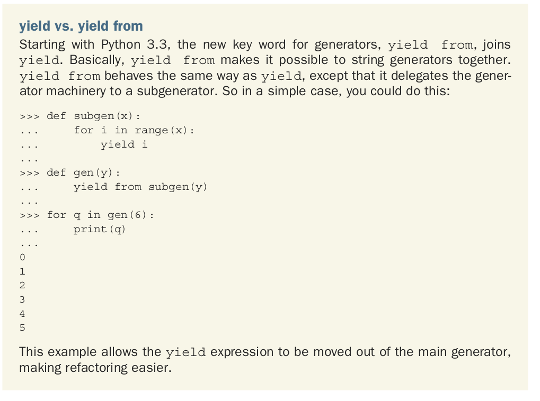

Slide 51
You can also use generator functions with in to see whether a value is in the series that the generator produces:
>>> 2 in four()
in generator, 0
in generator, 1
in generator, 2
True
>>> 5 in four()
in generator, 0
in generator, 1
in generator, 2
in generator, 3
False
You can find another example within the Materials repo.

Slide 52
Simplified Code
The simplification of code is a result of generator function and generator expression support provided by Python.
To illustrate this, we will compare different implementations that implement a function, "firstn", that represents the first n non-negative integers, where n is a really big number, and assume (for the sake of the examples in this section) that each integer takes up a lot of space, say 10 megabytes each.
Note: Please note that in real life, integers do not take up that much space, unless they are really, really, really, big integers. For instance you can represent a 309 digit number with 128 bytes (add some overhead, it will still be less than 150 bytes).
First, let us consider the simple example of building a list and returning it.
def first_n(n):
'''Build and return a list'''
num, nums = 0, []
while num < n:
nums.append(num)
num += 1
return nums
sum_of_first_n = sum(first_n(1000000))

Slide 53
The code is quite simple and straightforward, but it builds the full list in memory. This is clearly not acceptable in our case, because we cannot afford to keep all n "10 megabyte" integers in memory.
So, we resort to the generator pattern. The following implements generator as an iterable object.
# Using the generator pattern (an iterable)
class FirstN:
def __init__(self, n):
self.n = n
self.num = 0
def __iter__(self):
return self

Slide 54
def __next__(self):
if self.num < self.n:
cur, self.num = self.num, self.num+1
return cur
raise StopIteration()
sum_of_first_n = sum(FirstN(1000000))
This will perform as we expect, but we have the following issues:
there is a lot of boilerplate
the logic has to be expressed in a somewhat convoluted way
Furthermore, this is a pattern that we will use over and over for many similar constructs. Imagine writing all that just to get an iterator.

Slide 55
How it looks like with yield?
# a generator that yields items instead of returning a list
def first_n(n):
num = 0
while num < n:
yield num
num += 1
sum_of_first_n = sum(first_n(1000000))
Note that the expression of the number generation logic is clear and natural. It is very similar to the implementation that built a list in memory, but has the memory usage characteristic of the iterator implementation.

Slide 56
Generator expressions provide an additional shortcut to build generators out of expressions similar to that of list comprehensions.
In fact, we can turn a list comprehension into a generator expression by replacing the square brackets ("[ ]") with parentheses. Alternately, we can think of list comprehensions as generator expressions wrapped in a list constructor.
Consider the following example:
# list comprehension
doubles = [2 * n for n in range(50)]
# same as the list comprehension above
doubles = list(2 * n for n in range(50))
By allowing generator expressions, we don't have to write a generator function if we do not need the list. If only list comprehensions were available, and we needed to lazily build a set of items to be processed, we will have to write a generator function.
This also means that we can use the same syntax we have been using for list comprehensions to build generators.

Slide 57
More on generator expressions
Filtering Values
>>> even_squares = (x * x for x in range(10) if x % 2 == 0)
>>> even_squares
<generator object <genexpr> at 0x7f3fc2842510>
>>> for x in even_squares:
print(x)
0
4
16
36
64

Slide 58
In-line Generator Expressions
Because generator expressions are, well…expressions, you can use them in-line with other statements. For example, you can define an iterator and consume it right away with a for-loop:
for x in ('Bom dia' for i in range(3)):
print(x)

Slide 59
Too Much of a Good Thing…
Like list comprehensions, generator expressions allow for more complexity than what we’ve covered so far. Through nested for-loops and chained filtering clauses, they can cover a wider range of use cases:
(
expr for x in xs
if cond1
for y in ys
if cond2
...
for z in zs
if condN
)

Slide 60
The above pattern translates to the following generator function logic:
for x in xs:
if cond1:
for y in ys:
if cond2:
...
for z in zs:
if condN:
yield expr

Slide 61
And this is where I’d like to place a big caveat:
Please don’t write deeply nested generator expressions like that. They can be very difficult to maintain in the long run. This is one of those “the dose makes the poison” situations where a beautiful and simple tool can be overused to create hard to read and difficult to debug programs.

Slide 62
Key Takeaways
• Generator expressions are similar to list comprehensions. However, they don’t construct list objects. Instead, generator expressions generate values “just in time” like a class-based iterator or generator function would.
• Once a generator expression has been consumed, it can’t be restarted or reused.
• Generator expressions are best for implementing simple “ad hoc” iterators. For complex iterators, it’s better to write a generator function or a class-based iterator.

Slide 63
Iterator chains
Here’s another great feature of iterators in Python: By chaining together multiple iterators you can write highly efficient data processing “pipelines.”
While a regular function produces a single return value, generators produce a sequence of results. You could say they generate a stream of values over the course of their lifetime.
For example:
def integers():
for i in range(1, 9):
yield i
>>> chain = integers()
>>> list(chain)
[1, 2, 3, 4, 5, 6, 7, 8]

Slide 64
You can take the “stream” of values coming out of the integers() generator and feed them into another generator again. For example, one that takes each number, squares it, and then passes it on:
def squared(seq):
for i in seq:
yield i * i
This is what our “data pipeline” or “chain of generators” would do now:
>>> chain = squared(integers())
>>> list(chain)
[1, 4, 9, 16, 25, 36, 49, 64]

Slide 65
Why don’t we add another step to our pipeline that negates each value and then passes it on to the next processing step in the chain:
def negated(seq):
for i in seq:
yield -i
If we rebuild our chain of generators and add negated at the end, this is the output we get now:
>>> chain = negated(squared(integers()))
>>> list(chain)
[-1, -4, -9, -16, -25, -36, -49, -64]

Slide 66
My favorite thing about chaining generators is that the data processing happens one element at a time. There’s no buffering between the processing steps in the chain:
1. The integers generator yields a single value, let’s say 3.
2. This “activates” the squared generator, which processes the value and passes it on to the next stage as 3 × 3 = 9
3. The square number yielded by the squared generator gets fed immediately into the negated generator, which modifies it to -9 and yields it again

Slide 67
With a little trick, we can shrink down the definition of this pipeline even more, without sacrificing much readability:
integers = range(8)
squared = (i * i for i in integers)
negated = (-i for i in squared)
The only downside to using generator expressions is that they can’t be configured with function arguments, and you can’t reuse the same generator expression multiple times in the same processing pipeline.

Slide 68
Key Takeaways
• Generators can be chained together to form highly efficient and maintainable data processing pipelines.
• Chained generators process each element going through the chain individually.
• Generator expressions can be used to write concise pipeline definitions, but this can impact readability.

Slide 69
Improved Performance
The performance improvement from the use of generators is the result of the lazy (on demand) generation of values, which translates to lower memory usage.
Furthermore, we do not need to wait until all the elements have been generated before we start to use them. This is similar to the benefits provided by iterators, but the generator makes building iterators easy.
sum_of_first_n = sum([x for x in range(100000)])
# using a generator
sum_of_first_n = sum(xrange(1000000))
Note: a generator will provide performance benefits only if we do not intend to use that set of generated values more than once.

Slide 70
Decorators
At their core, Python’s decorators allow you to extend and modify the behavior of a callable (functions, methods, and classes) without permanently modifying the callable itself.
Any sufficiently generic functionality you can tack on to an existing class or function’s behavior makes a great use case for decoration.
This includes the following:
• logging
• enforcing access control and authentication
• instrumentation and timing functions
• rate-limiting
• caching, and more

Slide 71
Before decorators:
The method of applying a transformation to a function or method places the actual transformation after the function body. For large functions this separates a key component of the function's behavior from the definition of the rest of the function's external interface. For example:
def foo(self):
perform method operation
foo = classmethod(foo)
This becomes less readable with longer methods. It also seems less than pythonic to name the function three times for what is conceptually a single declaration. A solution to this problem is to move the transformation of the method closer to the method's own declaration. The intent of the new syntax is to replace
def foo(cls):
pass
foo = synchronized(lock)(foo)
foo = classmethod(foo)
with…

Slide 72
@classmethod
@synchronized(lock)
def foo(cls):
pass
Modifying classes in this fashion is also possible, though the benefits are not as immediately apparent. Almost certainly, anything which could be done with class decorators could be done using metaclasses, but using metaclasses is sufficiently obscure that there is some attraction to having an easier way to make simple modifications to classes.
**For Python 2.4, only function/method decorators are being added.

Slide 73
Design goals
work for arbitrary wrappers, including user-defined callables and the existing builtins classmethod() and staticmethod(). This requirement also means that a decorator syntax must support passing arguments to the wrapper constructor
work with multiple wrappers per definition
make it obvious what is happening; at the very least it should be obvious that new users can safely ignore it when writing their own code
be a syntax "that ... [is] easy to remember once explained"
not make future extensions more difficult
be easy to type; programs that use it are expected to use it very frequently
not make it more difficult to scan through code quickly. It should still be easy to search for all definitions, a particular definition, or the arguments that a function accepts

Slide 74
@dec2
@dec1
def func(arg1, arg2, ...):
pass
This is equivalent to:
def func(arg1, arg2, ...):
pass
func = dec2(dec1(func))
without the intermediate assignment to the variable func. The decorators are near the function declaration. The @ sign makes it clear that something new is going on here.

Slide 75
The rationale for the order of application (bottom to top) is that it matches the usual order for function-application. In mathematics, composition of functions (g o f)(x) translates to g(f(x)). In Python, @g @f def foo() translates to foo=g(f(foo).
The decorator statement is limited in what it can accept -- arbitrary expressions will not work. Guido preferred this because of a gut feeling.
The current syntax also allows decorator declarations to call a function that returns a decorator:
@decomaker(argA, argB, ...)
def func(arg1, arg2, ...):
pass
This is equivalent to:
func = decomaker(argA, argB, ...)(func)
The rationale for having a function that returns a decorator is that the part after the @ sign can be considered to be an expression (though syntactically restricted to just a function), and whatever that expression returns is called.

Slide 76
Examples
Define a class with a singleton instance. Note that once the class disappears enterprising programmers would have to be more creative to create more instances. (From Shane Hathaway on python-dev.)
def singleton(cls):
instances = {}
def getinstance():
if cls not in instances:
instances[cls] = cls()
return instances[cls]
return getinstance
@singleton
class MyClass:
...

Slide 77
Add attributes to a function. (Based on an example posted by Anders Munch on python-dev.)
def attrs(**kwds):
def decorate(f):
for k in kwds:
setattr(f, k, kwds[k])
return f
return decorate
@attrs(versionadded="2.2",
author="Guido van Rossum")
def mymethod(f):
...

Slide 78
Enforce function argument and return types.
def accepts(*types):
def check_accepts(f):
def new_f(*args, **kwds):
for (a, t) in zip(args, types):
assert isinstance(a, t), \
"arg %r does not match %s" % (a,t)
return f(*args, **kwds)
new_f.__name__ = f.__name__
return new_f
return check_accepts

Slide 79
def returns(rtype):
def check_returns(f):
def new_f(*args, **kwds):
result = f(*args, **kwds)
assert isinstance(result, rtype), \
"return value %r does not match %s" % (result,rtype)
return result
new_f.__name__ = f.__name__
return new_f
return check_returns

Slide 80
@accepts(int, (int,float))
@returns((int,float))
def func(arg1, arg2):
return arg1 * arg2

Slide 81
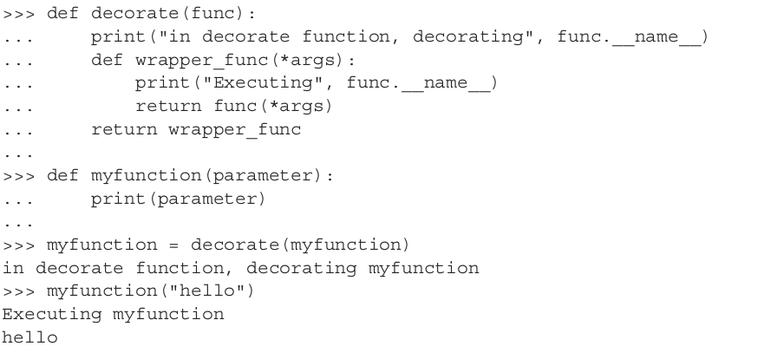

Slide 82
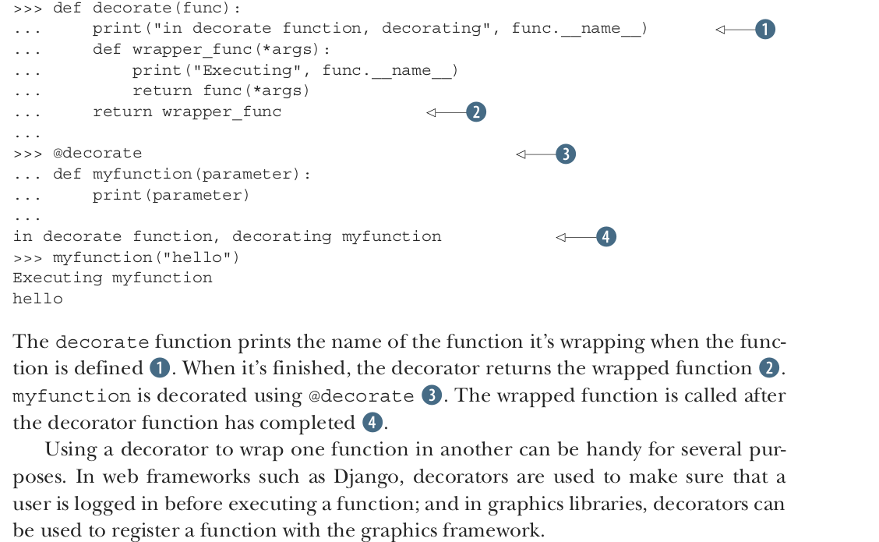

Slide 83
Decorators are specially useful when you need to apply certain new functionality on existing code and you don’t want to repeat yourself on each place, i.e. follow the DRY rule.

